Slide 1
Knowing Networking
Unit 5.1
Cybersecurity Boot Camp |

Slide 2

Welcome Back!
So … where are we again?
Notes:
A computer network is similar to a people network -

Slide 3


Previously on Cybersecurity…
Terminal, Python, Crypto
Notes:
Recap previous week (bridge)

Slide 4

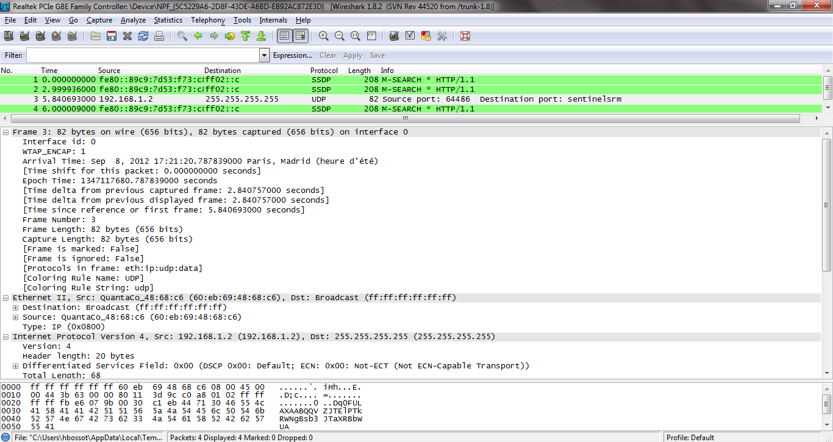

This Week on Cybersecurity…
Networking, Wireshark
Notes:
Talk about what’s upcoming this week

Slide 5
Where are we?
Security Analyst | Security Operations Center (SOC) Analyst | Security Engineer | Systems Engineer
Cyber Threat Analyst | Cyber Defense Analyst | Incident Response Analyst | Intelligence Analyst
Information Assurance Technician | Risk Analyst | Forensics Investigator | Systems Administrator
Network Engineer | IT Auditor | Application Security Engineer | Penetration Tester
Information Analyst | Systems Security Analyst | IT Specialist | Web Engineer – Application Security
Networking is critical for nearly all of these roles. A solid understanding of networking is fundamental to almost all of cybersecurity.
Notes:
Talk about where we are in the context of the overall course (networking – learning how computers communicate) Blue squares denote areas where these skills are particularly relevant.

Slide 6
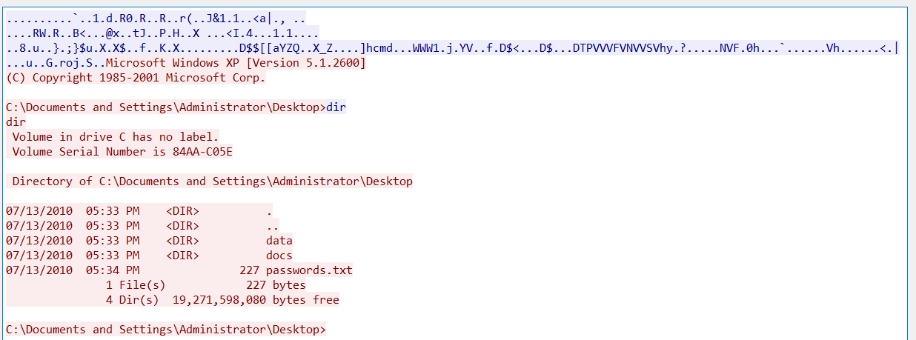
Networking
Wireshark is used often by Network Admins, Penetration Testers, security specialists, and in the forensics industry.
Soon we’ll be analyzing capture files to identify malicious actors and malware sent on the network. Pretty cool.
Notes:
A computer network is similar to a people network -

Slide 7
Today’s Goals
By the end of class, you will be able to:
Define Network and understand the principles by which computers communicate
Define Protocol and their relevance in network communication
Define OSI Model and explain each layer
Map communication types and protocols to OSI Model layers
Explain the steps of network communication in the context of the OSI Model
Notes:
But today, we’re going to… Review goals, address questions.

Slide 8
The Journey of a File

Slide 9

Network
How does a file get from my computer to yours?
Notes:
A computer network is similar to a people network -

Slide 10
Network
No magical floating “cloud”s raining files on you.
Computers send files to each other over a network
Notes:
A computer network is similar to a people network -

Slide 11

Network
A network is a group of devices that can communicate.
When devices are connected and communicate, they can share data.
Notes:
A computer network is similar to a people network -

Slide 12


People Network
Almost everyone in the world is connected given enough “hops”
Notes:
A computer network is similar to a people network – people know each other through various connections, and communicate using a variety of methods (talking, texting, tapping on the shoulder).

Slide 13

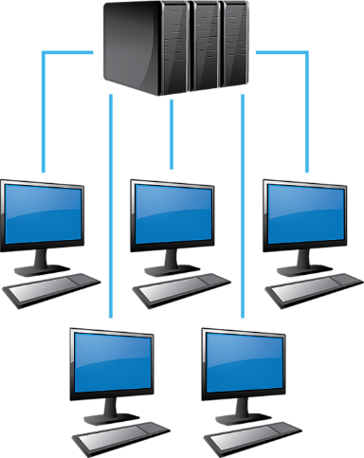
Computer Network
The same is true for computers – the Internet is a giant network of connected computers
Map of how computers connect to one another, with one server broken out
Notes:
One server in a huge map of the internet

Slide 14
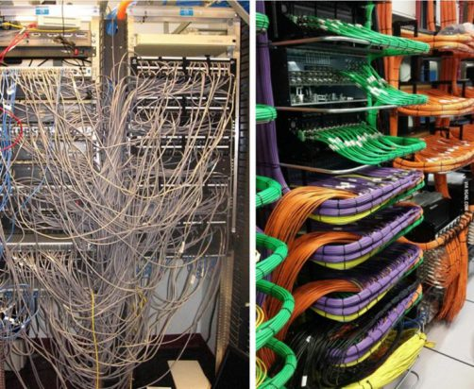
Connecting Computers
A Computer Network uses wired (and wireless) connections to transmit data between connected devices.
Devices: Computers, Phones, Tablets …
Data: Web Pages, Images, Videos, Music, Connection info …
A data center with thousands of networked computers
Notes:
People are the same way

Slide 15

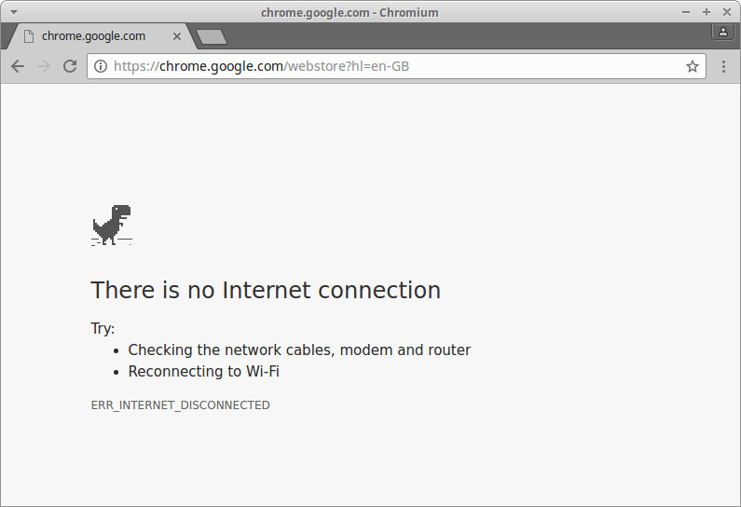
Network Communication
Network communication is the sending of information between network connected devices.
Without a network, computers
aren’t be able to communicate.
Many common errors involve problems with connection.

Slide 16

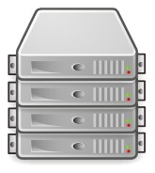
Network Communication
Client
Server
Much of network communication happens between clients and servers

Slide 17
Network Communication
Client
Server
Clients can be anything! Computers, phones, cameras… anything network connected!
They may request files, maps, web pages, weather data, …. the list goes on.
Servers can be anywhere! But … they are usually a computer in a warehouse somewhere.
They can respond to clients, communicate with databases, do complex calculations, and more.

Slide 18
Network Communication
Client
Server
Clients and servers communicate back and forth

Slide 19


Network Communication
Often, multiple clients communicate with a single server
Notes:
Phone, computer, smart bulb …

Slide 20


Network Communication
Client/Server Model
Magic … for now

Slide 21
Network Communication
Request/Response
1
The client sends a request for info to the server
The server responds with data
2

Slide 22
Network Communication
Request
I’d like file X please

Slide 23

Network Communication
Response
Let me find file X for you…
I’d like file X please

Slide 24

Network Communication
Response
I’d like file X please
Here’s file X you asked for!

Slide 25

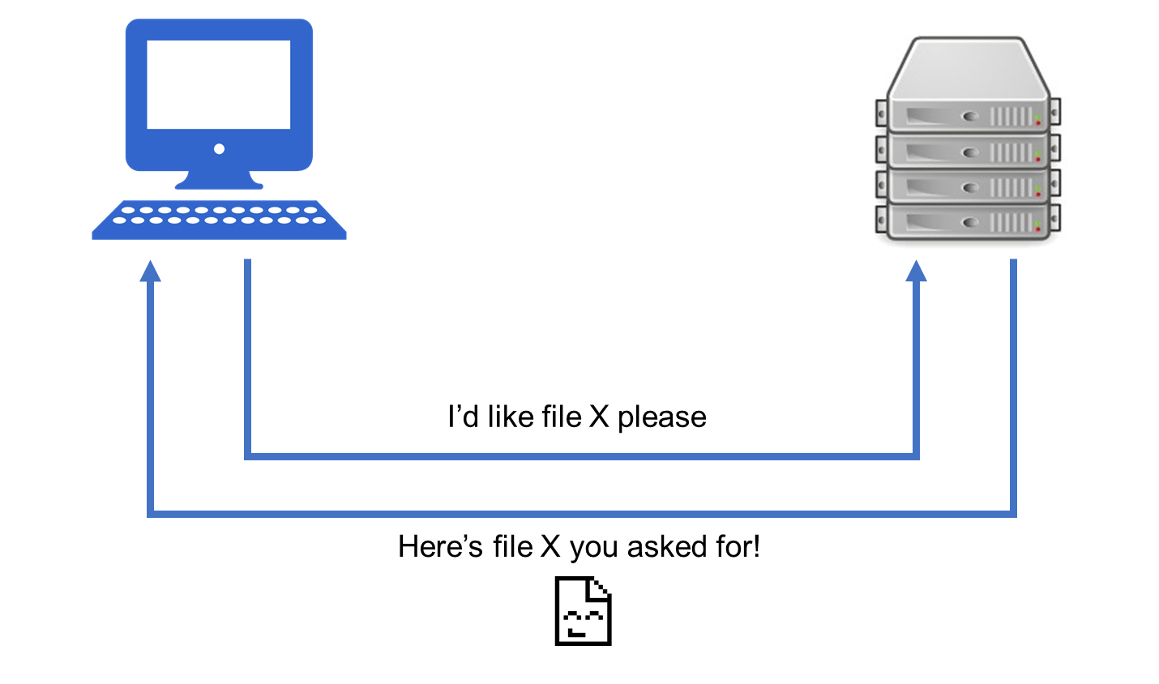
Request/Response
How is this request made? How is it sent?
How does the client find the server, and vice-versa?
Actual process is … more in depth. Lots of magic in our current understanding. But we’ll get there!
How is this file found? How is it sent?

Slide 26

Network Communication
For now, focus on the high-level: it is critical that you are able to explain how network communication works to people in the field (potential interviewers)
Notes:
A computer network is similar to a people network -

Slide 27
Activity: Explaining Communication (10 min)
With a partner, investigate and explain how each of the following might work in communicating over the network:
File Transfer
Email
Web Page
For each scenario, think about and try to explain each of the following:
Who is the client? The server?
What does the request look like? The response?
What work does the client do? The server?
What is being communicated?
Feel free to use a search engine to help you in your investigation!

Slide 28
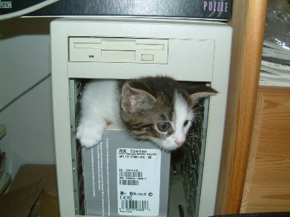
Review Explaining Communication - File Transfer
I’d like file X please
Here’s file X you asked for!

Slide 29
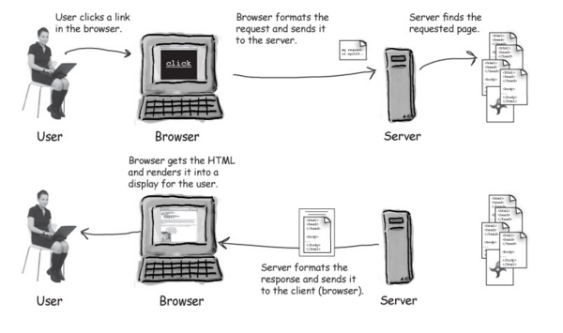
Review Explaining Communication - Web Pages

Slide 30


Review Explaining Communication - Email
Client - Sender Nick
Client – Receiver Peleke
Mail Server
To: peleke@yo.yo From: nick@yo.yo Yo Yo Yo! How it go?
To: peleke@yo.yo From: nick@yo.yo Yo Yo Yo! How it go?

Slide 31

Review Explaining Communication - Email
Client - Sender Nick
Client – Receiver Peleke
Mail Server(s)
To: peleke@yo.yo From: nick@yo.yo Yo Yo Yo! How it go?
To: peleke@yo.yo From: nick@yo.yo Yo Yo Yo! How it go?
For some types of communication there may be more than one server behind the scenes doing work.

Slide 32

Networking Definitions
Network
A system of computers and other devices (such as printers) that are connected to each other.
Network Communication
Transmission of data between two or more computers over a network.
Client/Server
Multiple end devices (clients) communicating over a network with a single central computer (server).
Request/Response
A basic method of computer communication, in which one computer sends a request for data to a second computer, and the second responds to the request.

Slide 33
Networking Complexities – 0s and 1s

Slide 34
Dispelling the Magic
How is this request made? How is it sent?
How does the client find the server, and vice-versa?
Time to start diving in to some of this magic. Let’s start with how the data is communicated.
How is this file found? How is it sent?

Slide 35



How Computers Work
Nearly everything on the internet is communicated via 0s and 1s, known as binary.
Text? 0s and 1s
Images? 0s and 1s
Music? 0s and 1s

Slide 36

Why Binary?
Binary (base-2) is a numbering scheme in which there are only two possible values for each digit: 0 and 1.
Computers operate in binary – they store data and perform calculations using only 0s and 1s – this is due to physical limitations of electronic circuits.
0s and 1s are associated with “no signal” or “signal” (off/on).
Notes:
Explain that the reason we use 0s and 1s is tied to how electrical circuits work

Slide 37
0s and 1s – Numbers
Strings of 0s and 1s can be used to represent specific information. They can be used to represent raw numbers:
3 = 2¹ + 2⁰
5 = 2² + 2⁰
7 = 2² + 2¹ + 2⁰
1100001 = 2⁶ + 2⁵ + 2⁰ = 97
1110100 = 2⁶ + 2⁵ + 2⁴ + 2² = 116
10101 = ?
Decimal | Binary
0 | 000
1 | 001
2 | 010
3 | 011
4 | 100
5 | 101
6 | 110
7 | 111
Notes:
Don’t get too much into binary calculations here
Take a second to let the class do the final calculation

Slide 38
0s and 1s – Numbers
Strings of 0s and 1s can be used to represent specific information. They can be used to represent raw numbers:
3 = 2¹ + 2⁰
5 = 2² + 2⁰
7 = 2² + 2¹ + 2⁰
1100001 = 2⁶ + 2⁵ + 2⁰ = 97
1110100 = 2⁶ + 2⁵ + 2⁴ + 2² = 116
10101 = 2⁰ + 2² + 2⁴ = 1 + 4 + 16 = 21
Decimal | Binary
0 | 000
1 | 001
2 | 010
3 | 011
4 | 100
5 | 101
6 | 110
7 | 111
Notes:
Explain that in this final calculation, we have 2⁰ + 2² + 2⁴
Explain that it is often easer to think about it right-to-left

Slide 39
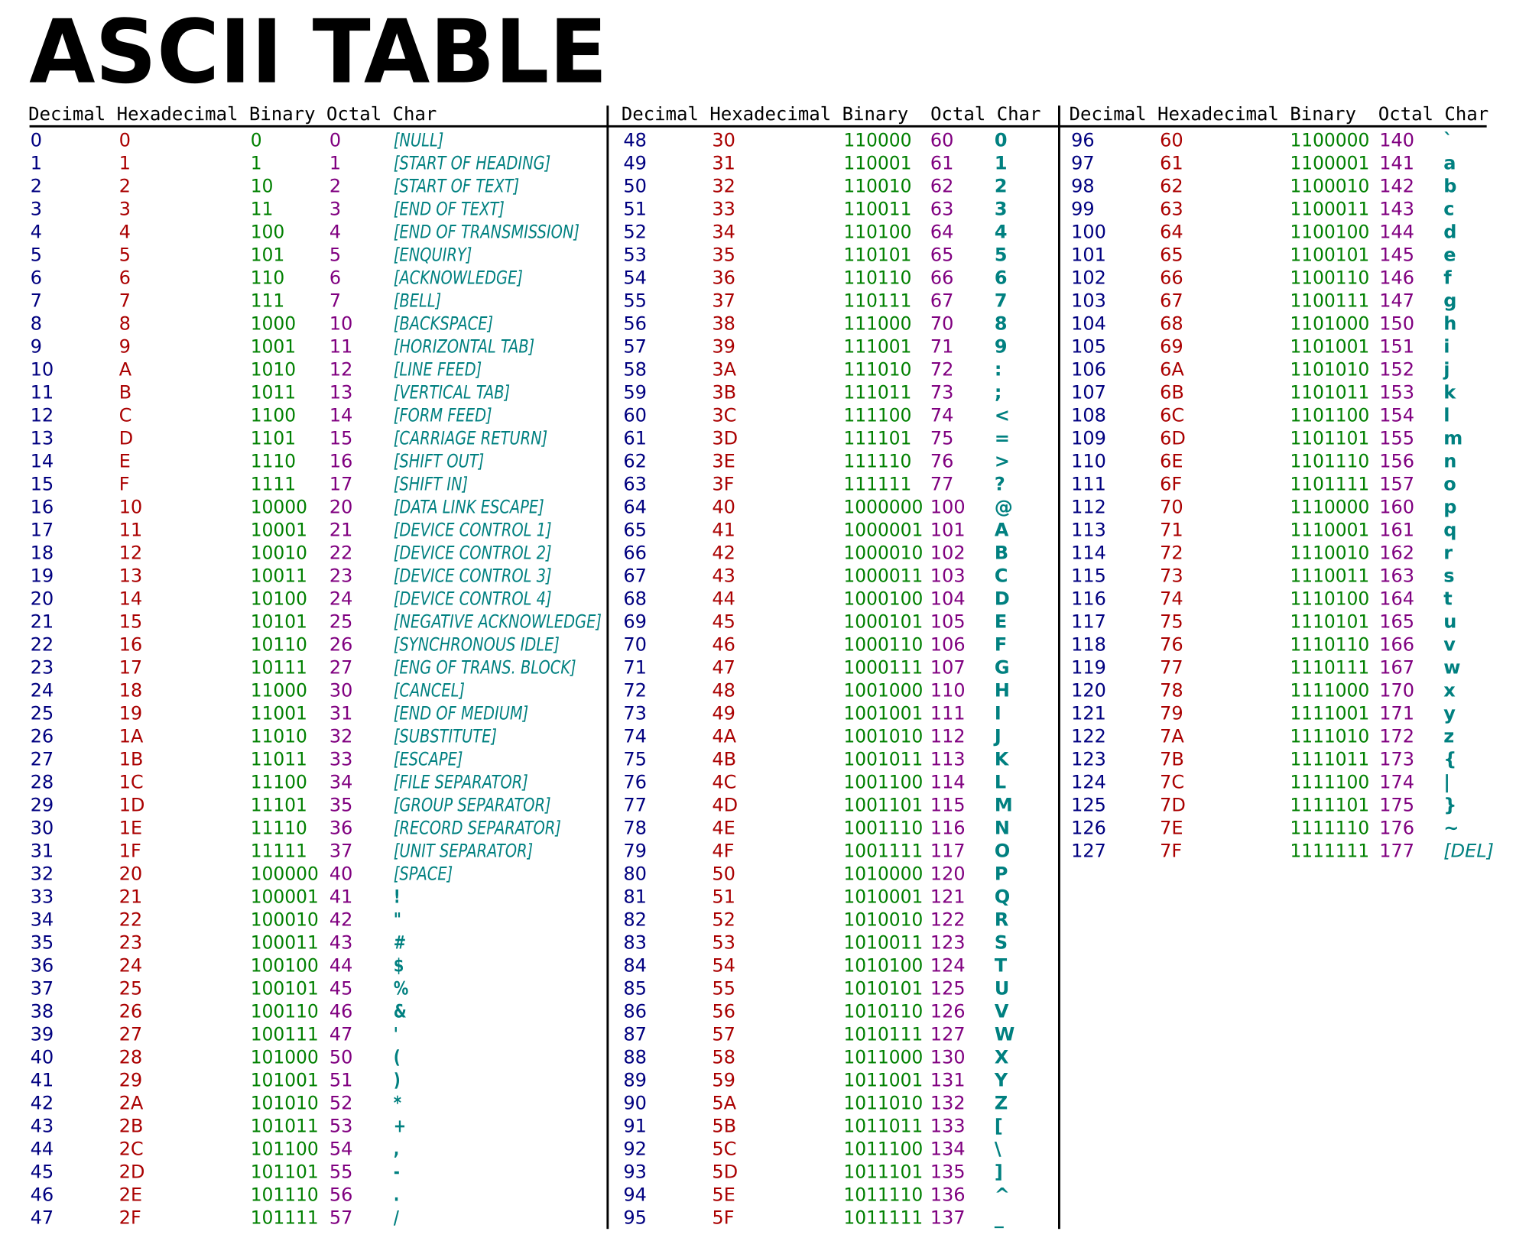
0s and 1s – Text
Binary representations can be used to denote characters using ACII
1100001 = 2⁶ + 2⁵ + 2⁰ = 97 = a
Each decimal/binary number between 0 and 127 (0000000 and 1111111) represents a different character
Notes:
Don’t get too much into binary calculations here

Slide 40
0s and 1s – Text

Slide 41
0s and 1s – Images
How??
000000010010000000010010011110000000

Slide 42
0s and 1s – 1 bit color image
0 | 0 | 0 | 0 | 0 | 0
0 | 1 | 0 | 0 | 1 | 0
0 | 0 | 0 | 0 | 0 | 0
0 | 1 | 0 | 0 | 1 | 0
0 | 1 | 1 | 1 | 1 | 0
0 | 0 | 0 | 0 | 0 | 0
000000
010010
000000
010010
011110
000000
0 = white
1 = black
000000010010000000010010011110000000
Notes:
Break image into “pixels”, and associated a color with each pixel

Slide 43
0s and 1s – 2 bit color image
00 | 00 | 00 | 00 | 00 | 00
00 | 01 | 00 | 00 | 01 | 00
00 | 00 | 00 | 00 | 00 | 00
00 | 11 | 11 | 11 | 11 | 00
00 | 11 | 10 | 10 | 11 | 00
00 | 00 | 00 | 00 | 00 | 00
000000000000
000100000100
000000000000
001111111100
001110101100
000000000000
00 = white 01 = blue
10 = pink 11 = black
000000000000000100000100000000000000001111111100001110101100000000000000
Notes:
Most common image formats today use 24 bits for color (2^24 = 16,777,216 color variations)

Slide 44

Network Communication
Here’s file X you asked for!
“I’d like file X please”
“I’d like file X please”
Here’s file X you asked for!
111000100101010100010011100
000110010101101011010111001
000110010101101011010111001
111000100101010100010011100

Slide 45
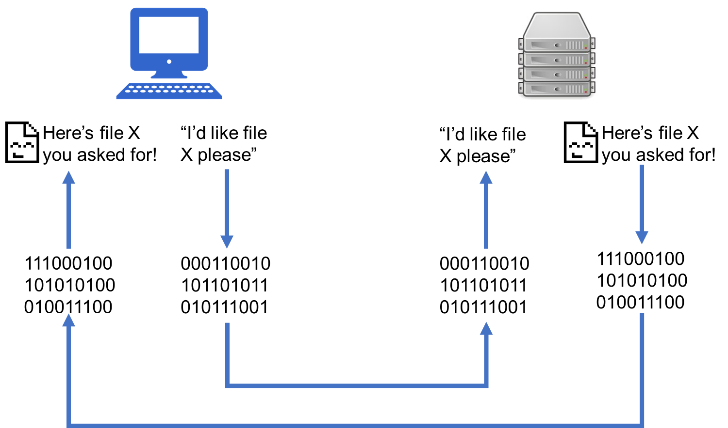
Request/Response and Binary
The request – “I’d like file X please” must be converted to binary to be sent electronically
The response – the file – must also be converted to binary to be sent electronically

Slide 46
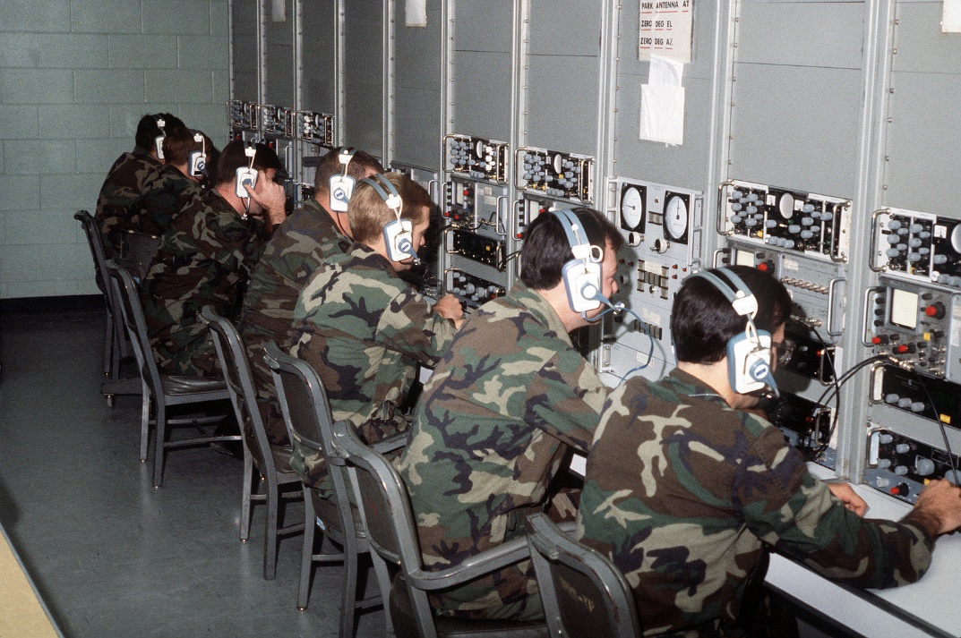
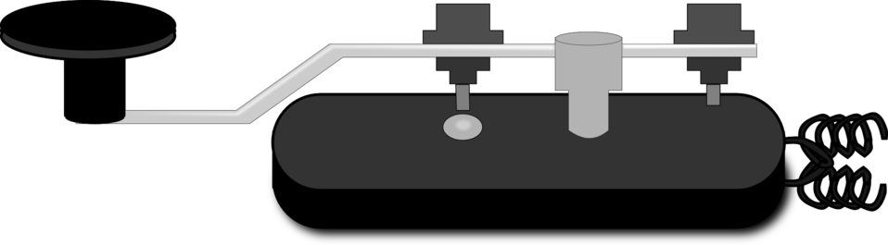
Request/Response and Binary
Communication over the network is complex.
Only being able to use 0s and 1s imposes huge limitations on communication – limitations which are to recognize unless actively encountered.
Enter … Morse code
Notes:
We’re going to emulate a network by only using Morse code to communicate with one another.

Slide 47
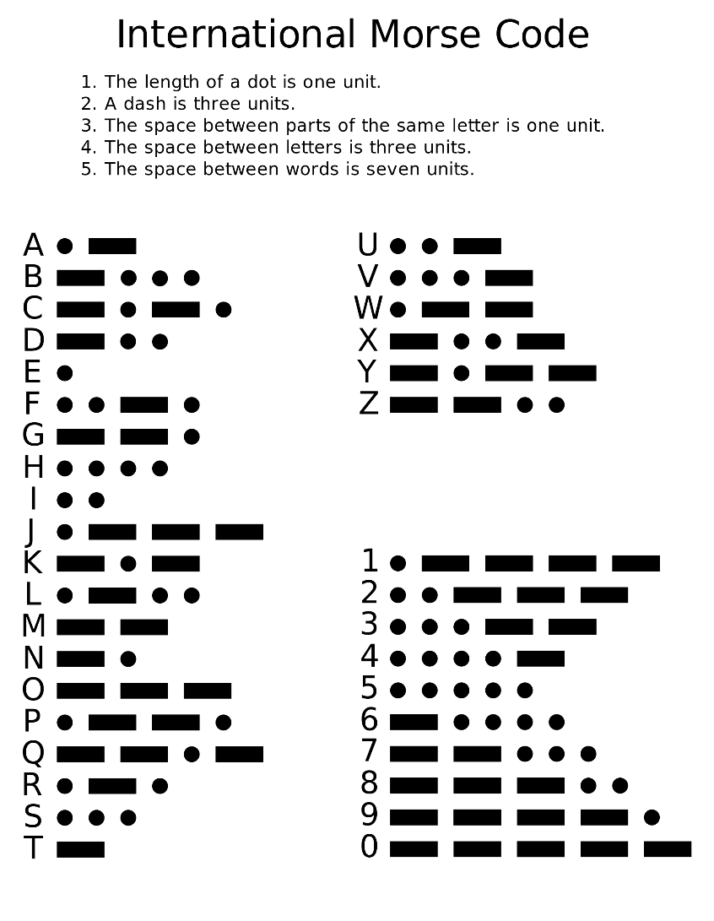
Activity: Morse Code pt. 1 (10 min)
Time to see what communicating with heavy limitations looks like. You’re not allowed to talk during this activity, except in Morse code!
Instructions:
Work with a Partner. Each person should:
Write your own secret message (6+ words) in English.
Use the provided Morse code alphabet to convert your message to Morse code, written on a separate piece of paper.
Next, trade pieces of paper. Decode the other person’s message, converting it from Morse code to English. Have your partner verify the message.
Bonus:
Try having a short conversation

Slide 48
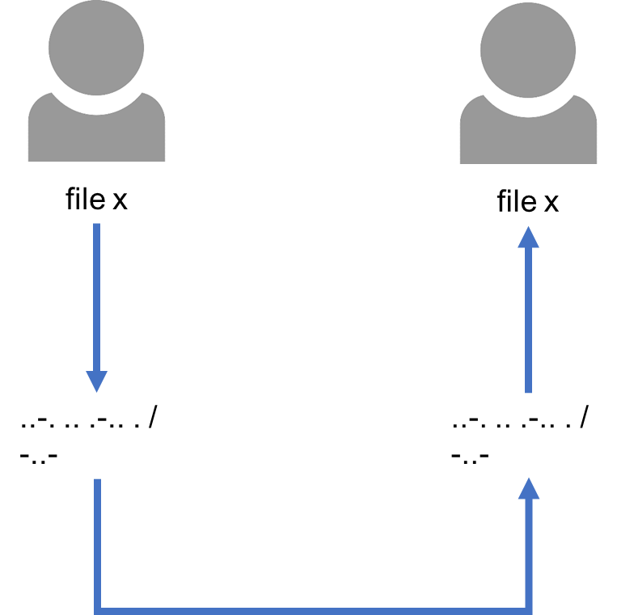
Review Morse Code
Steps in Morse code:
Message is created in a user-friendly language (English)
Message is converted to a language which is easy to transmit. (Morse code)
Message is transmitted
Message is received as Morse code
Message is decoded
1
5
2
4
3

Slide 49
Morse vs. Binary
..-. .. .-.. . / -..-
f i l e x f - 01100110 i - 01101001 l - 01101100 e - 01100101 space - 00100000 x - 01011000

Slide 50

Network Communication
file x
file x
file x
file x
01100110 01101001 01101100 01100101 00100000 01011000
01100110 01101001 01101100 01100101 00100000 01011000
..-. .. .-.. . / -..-
..-. .. .-.. . / -..-

Slide 51
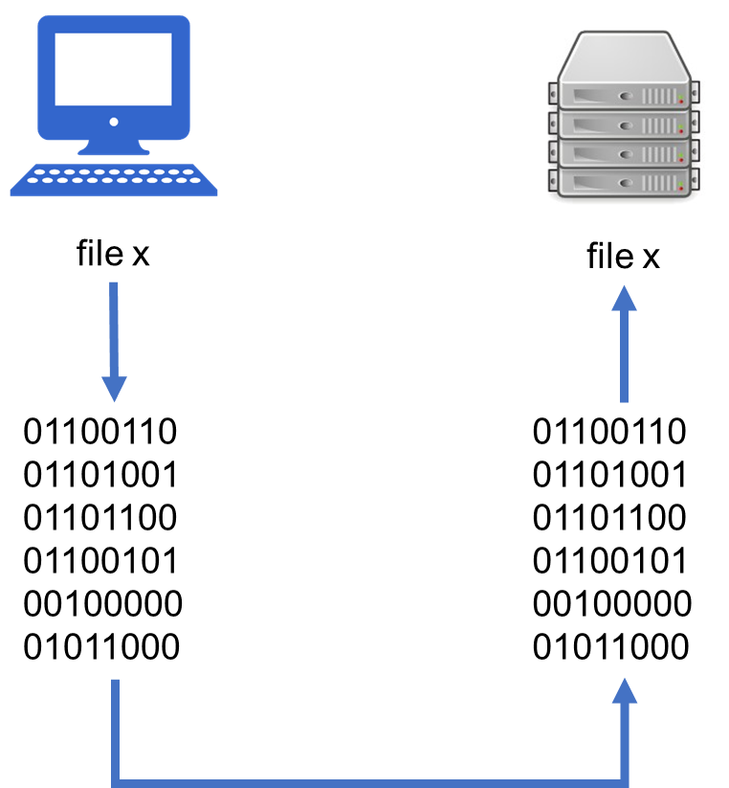
Morse vs. Binary
Sending the message “file x” in Morse code and binary.

Slide 52
Review Morse Code
The Morse code message is much shorter than the binary. Why?

Slide 53
Review Morse Code
The Morse code message is much shorter than the binary. Why?
Binary is always just 0s and 1s – two elements.
Morse code is more “expressive” – five elements:
short mark, dot or "dit" (▄): "dot duration" is one time unit long
longer mark, dash or "dah" (▄▄▄): three time units long
inter-element gap between the dots and dashes within a character: one dot duration or one unit long
short gap (between letters): three time units long
medium gap (between words): seven time units long
Notes:
Morse code uses time and gaps in signal to help indicate additional meaning.

Slide 54
Review Morse Code
The Morse code message is much shorter than the binary. Why?
This means that given 4 characters:
Morse code can use different combinations of characters and pauses to communicate many different things in a short number of characters.
Binary 2⁴ = 16
Morse 5⁴ = 625
Notes:
Morse code uses time and gaps in signal to help indicate additional meaning.

Slide 55
Limitation in Communication
So, 0s and 1s is a significant limitation.
However, network communication isn’t just limited by 0s and 1s and binary. There are other complexities as well.
Let’s think about what other complexities might exist with Morse code to help us draw parallels when it comes to communicating over the network.
Notes:
With binary, it’s always either on/off. With Morse, you have off (pause), short, and long. Timing and length make these signals mean different things.

Slide 56
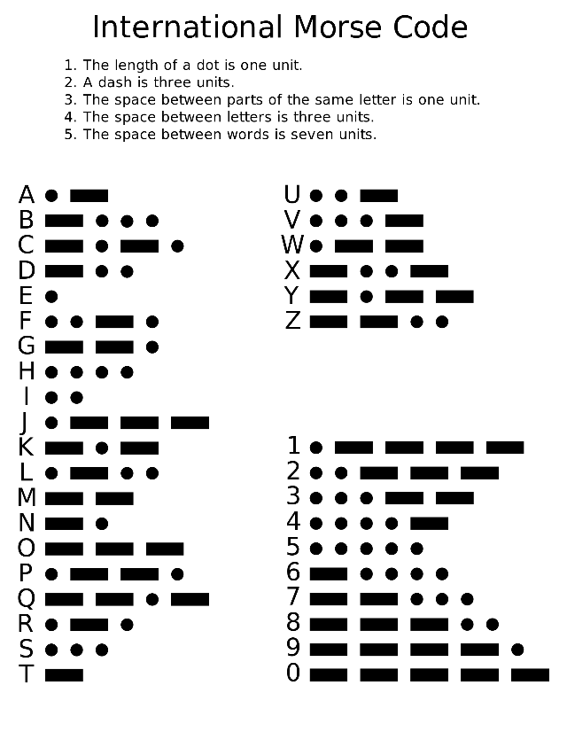
Activity: Partners Morse Code pt. 2 (10 min)
Time to have a conversation, but this time you’re forbidden from looking at each other, and must say the Morse code out loud. Work with a partner!
Instructions:
Person 1: start the conversation by sending some Morse code as a vocal message.
Person 2: listen, write down the message, and decode it.
Person 2: form a response message and send it vocally as Morse code.
Person 1: listen, write down the message, and decode it.
Repeat these steps until the conversation is finished
As you act out the above steps, take note of any difficulties you encounter. Specifically, any ambiguities, uncertain pauses, confusion, etc.

Slide 57
Review Morse Code pt. 2 struggles
Some of the challenges of communicating via Morse code:
Starting a conversation (who and how)
Ending/waiting for response
Noting that a message was received/is being processed
Explaining that a message was or was not understood
Denoting a response
Ending the conversation completely

Slide 58
Review Morse Code pt. 2 struggles
In the real world with network communication, it’s more complex and there are more difficulties.
It would be really helpful to have a set of agreed-upon rules to help us better understand and parse our content…

Slide 59
Protocols

Slide 60

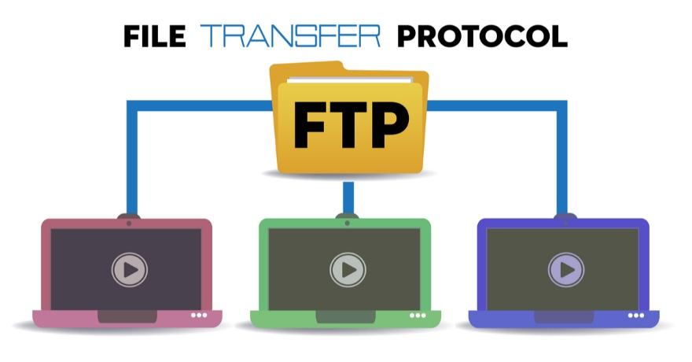
Protocols
A protocol is a set of standardized rules that specify how interactions between communicating entities should work.
While networks are all about how computers connect, protocols are about how they communicate.

Slide 61
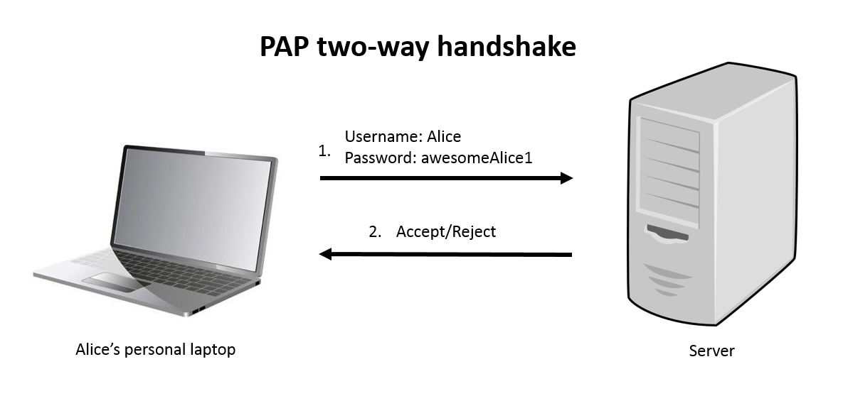
Protocol Example - Authentication
PAP - Password Authentication Protocol
Client sends an authentication request containing the username and password to the server
The server responds with either an acknowledgement if the credentials are okay or a “nak” otherwise.
Notes:
PAP is a simple user validation protocol.
Nak – not acknowledged

Slide 62
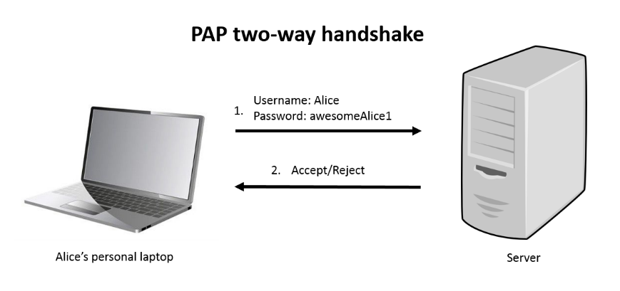
Protocol Example - Authentication
PAP
The client forms the initial request, which must contain bits in a specific order and of a specific length, per the standards and rules of the protocol:
Before communicating, they’ve agreed upon a standard, consistent way to communicate.
1 byte | 1 | 2 bytes | 1 byte | Variable | 1 byte | Variable
Code: 1 | ID | Length | User name length | User name | Password length | Password
Notes:
This protocol requires a code, id, and lengths for the username/password be sent along in addition to the username and password themselves.

Slide 63
Protocol Example - Authentication
PAP The server upon receiving the request will know where in the bit stream to look for the content – the username and password.
These rules allow you to find important information in a world of just 0s and 1s.
1 byte | 1 | 2 bytes | 1 byte | Variable | 1 byte | Variable
Code: 1 | ID | Length | User name length | User name | Password length | Password

Slide 64
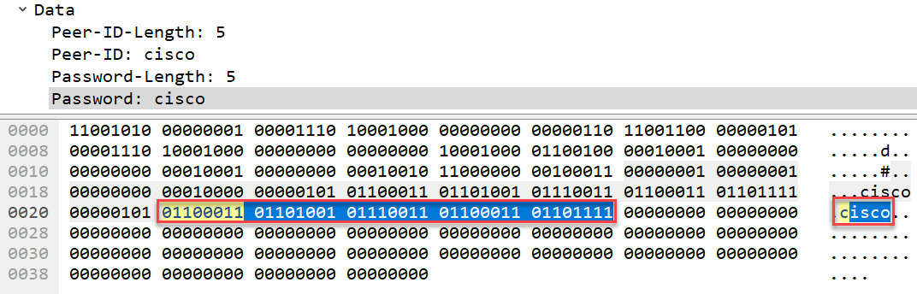
Protocol Example - Authentication
The protocol rules are shaped by the problem they’re trying to solve and the data being communicated.
With PAP, this means denoting exactly where in all of the bits sent the username and password are:

Slide 65
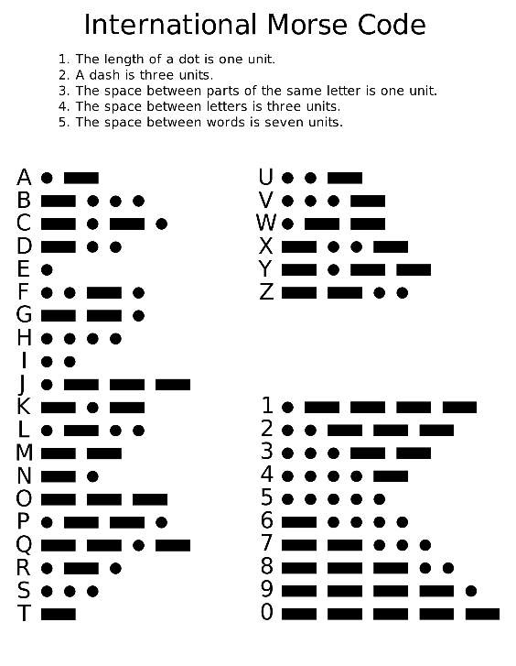
Activity: Morse Code pt. 3 (15 min)
One final conversation with your partner, again you’re forbidden from looking at each other once the conversation has started, and you must say the Morse code out loud. This time though, you’re going to first define a protocol (rules) to ease communication.
Instructions:
Using the list of struggles we identified, define a set of signals and rules which will ease conversation.
Have one person start the conversation, and use the signals and rules you defined.
After conversing using these rules, iterate on the rules to improve and/or fill any gaps from before.
Bonus:
Build a few “shorthand” signals that make communication easier, such as for “Thank you”, “Are you there?”, or “Still thinking.”
Try communicating a simple number or drawing. Build an additional set of rules to think about making that communication easier.
Notes:
Must stay within the bounds of Morse code – no new characters.

Slide 66
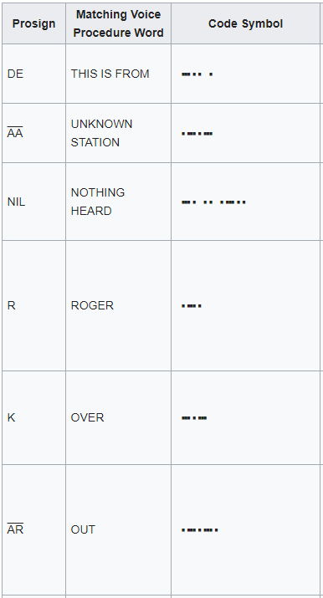
Review Morse Code pt. 3
Morse code already has some built in rules inherent to the conversation (how long the space between letters, words is)
In addition to those rules, International Morse code has “procedure signs” (prosigns) which when used improve speed and performance of communication.
These rules are defined in a standardized specification (similar to most protocols)
Notes:
https://en.wikipedia.org/wiki/Prosigns_for_Morse_code#Official_International_Morse_code_procedure_signs

Slide 67
Review Morse Code pt. 3
Communication protocols typically define at least:
How to INITIATE communications
How to indicate a message is DONE
How to indicate that the exchange is OVER
These rules help us solve problems we encountered using Morse code:
Problem | Prosign | Voice Equivalent
Starting conversation (who and how) | KA | ATTENTION
Ending/waiting for response | K | OVER
Noting that a message was received | R | ROGER
Explaining that a message not understood | ? | SAY AGAIN
Who is sending this message | DE | THIS IS FROM
Ending the conversation completely | AR | OUT

Slide 68

Protocols in Networking
Just receiving a bit stream would be extremely difficult for computers to parse.
Imagine getting this:
How do I know what this is? An image? Text? Music? Slideshow?
Protocols enable you to communicate metadata about how to read and understand the data that follows.

Slide 69
Bonus: MIP – Morse Image Protocol?
To communicate more complex information (like black and white images) via Morse code, we have to add additional rules.
IMGGO 6 7 eteeeteteteteteeeeeeeteeeeeteteeeteeetttee
.. -- --. --. --- -.... --... . - . . . - . - . - . - . - . . . . . . . - . . . . . - . - . . . - . . . - - - . .
The rules we’ve created here would be that:
Start the image message by sending the IMGGO sign
Immediately following that signal send the number of rows and then columns
Send row*column signals denoting the color of each pixel, starting in the top left of the image and moving row-wise to the bottom right.
e = white, t = black (easier than 0s and 1s – much longer signal)
Other rulesets could work too!

Slide 70
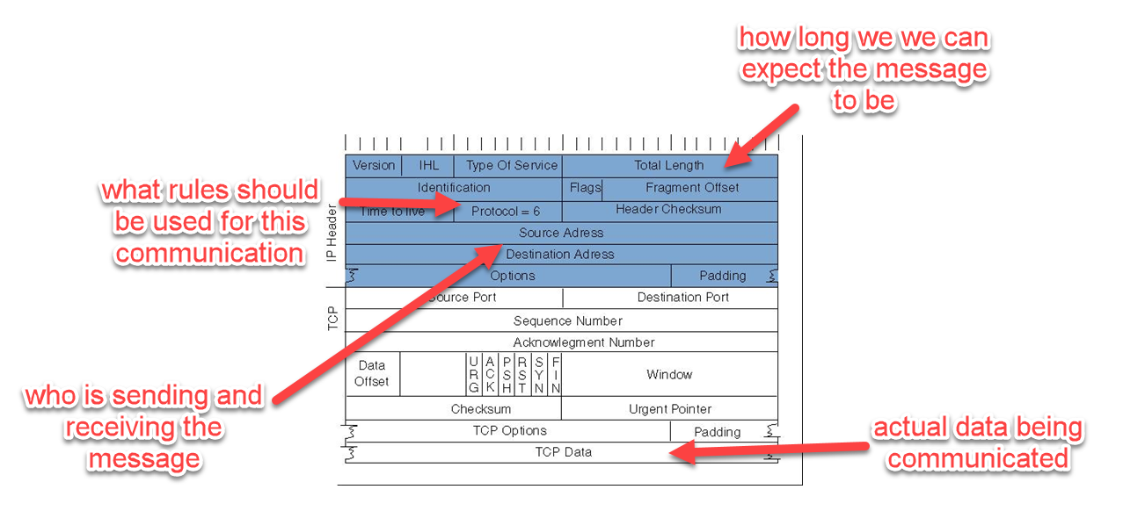
Protocols in Networking
Hundreds of protocols exist in the space of computer networking, and we’ll be diving into some of them this week, though it’s impossible to cover them all.
Protocols define how data should be interpreted, enabling communication
Example TCP/IP (Transmission Control Protocol/Internet Protocol) header:
Notes:
Don’t get into the header info! Just an example
In networking, TCP (Transmission Control Protocol) and IP (Internet Protocol) help define information about how communication should take place, and what is being communicated.

Slide 71
Break (15 min)

Slide 72
The OSI Model

Slide 73
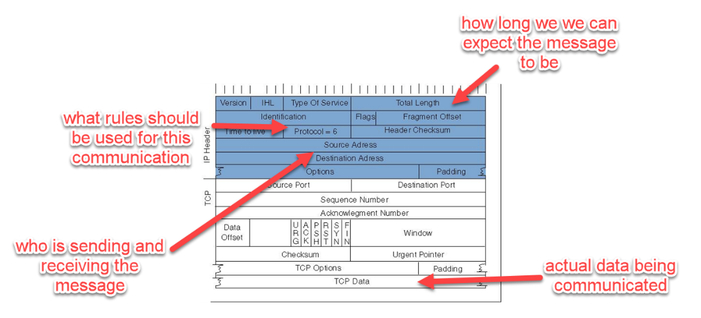
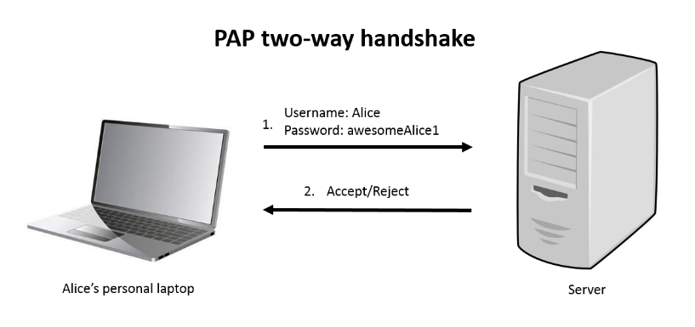
The OSI Model
Hundreds of protocols exist in the space of computer networking…

Slide 74
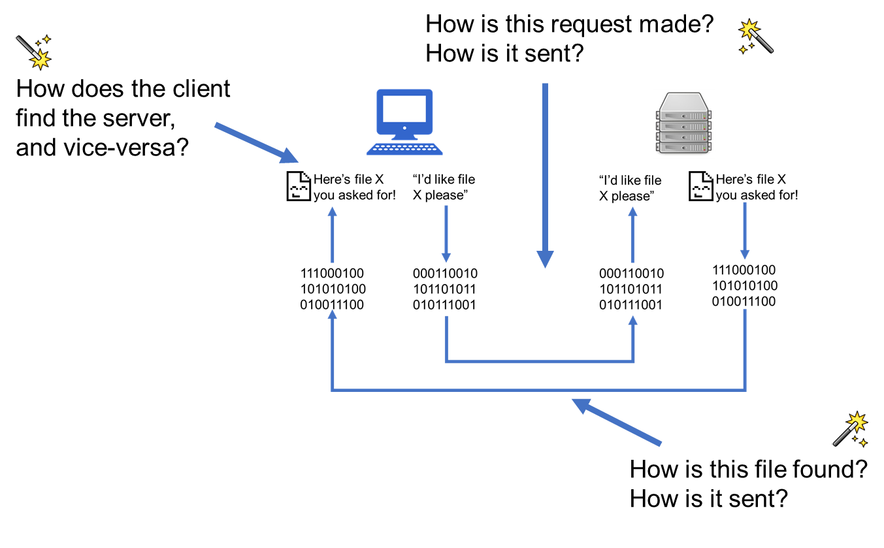
The OSI Model
Also, there’s still a lot of magic here.
Sure, Request/Response.
Sure, everything is communicated via 0s and 1s.
But how?

Slide 75

The OSI Model
That’s a lot of protocols and magic
Notes:
That might be intimidating

Slide 76
The OSI Model
There are going to be a lot of new terms.
Over the course of the next 3 weeks we’ll be diving in to many of the mentioned protocols, devices, and processes. Don’t get too caught up on any one term. Focus on the model itself.
Notes:
It’s a lot to cover!
For now, understanding at a high-level how network communication works is most important. We’ll use this model as context for … forever.

Slide 77
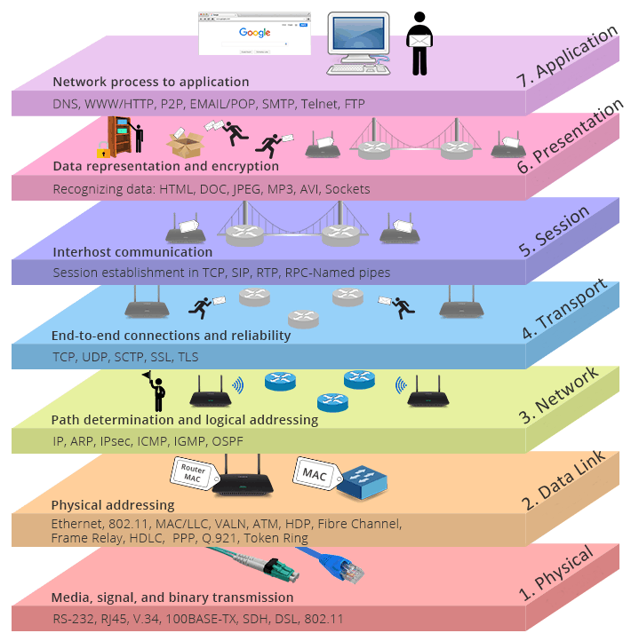
The OSI Model
The OSI Model
Open Systems Interconnection model
Way to think about communication over the network
Categorizes protocols, processes, and devices into “layers”
Notes:
Fortunately, there’s a well-defined model for thinking about network communication
Helps categorize and build a mental model around how communication works at each layer of the network, and understand the processes, devices, and protocols in place.

Slide 78
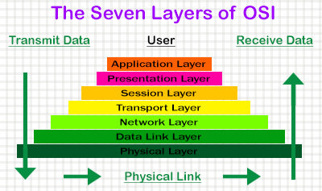
The OSI Model
The OSI Model is broken into 7 layers, each with its own responsibility.
It’s not always an exact science as to what behavior belongs to what layer.
We’ll use the OSI model often throughout the course to contextualize new concepts into an overall model for network communication.

Slide 79
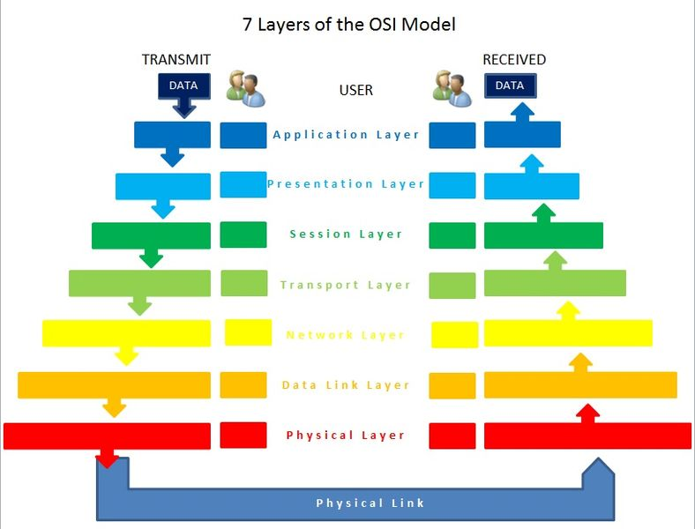
The OSI Model
Application
Presentation
Session
Transport
Network
Data Link
Physical

Slide 80
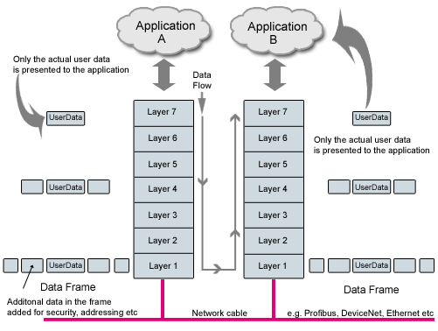
The OSI Model
HTML Request with the OSI Model
Upon triggering a network communication, data goes through encapsulation and decapsulation processes.

Slide 81
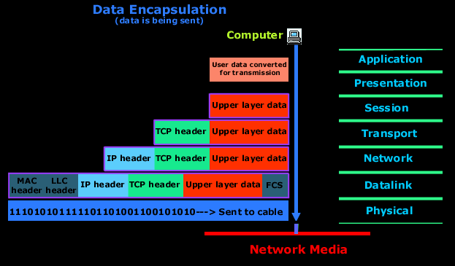
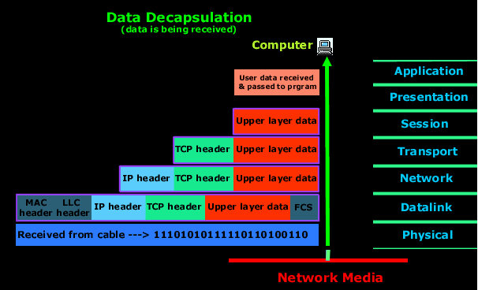
The OSI Model
Encapsulation and Decapsulation

Slide 82
The OSI Model - Encapsulation
Encapsulation converts data from an application on the source machine (e.g. an image) into something that can be transmitted
As you go through each layer of the process, headers are added to help with transmission and to aid in the de-encapsulation process.

Slide 83
The OSI Model - Encapsulation
Decapsulation converts data transmitted over the network into something that can be used on the destination machine’s application
All of the headers added during encapsulation are now used to let the destination machine know how to use the data, and are stripped

Slide 84
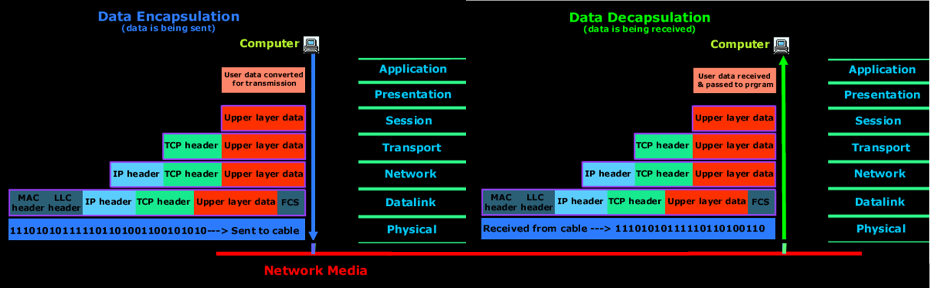
The OSI Model
Each step in the encapsulation and decapsulation process takes advantage of protocols and/or devices to convert and send/receive data
Mapping actions and processes to layers will help you break down the complexities of network communication

Slide 85
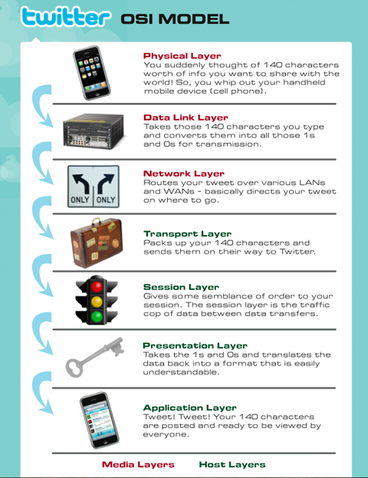
The OSI Model
You can think of each layer of the model as accomplishing some task.
In this case with a tweet, you’re converting your 140 character tweet into 0s and 1s, and then sending that tweet over the network.
Notes:
This graphic mixes what each layer is doing on the phone’s end and on twitter’s server’s end. They accomplish the same general task though, just in the reverse order.

Slide 86
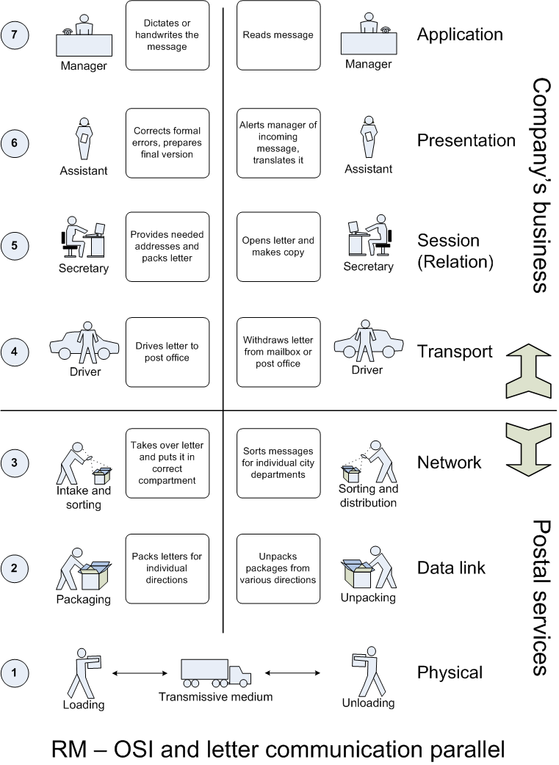
The OSI Model
Information being sent over the network is very similar to a letter being written and sent – and both can be thought of similarly when it comes to modelling them.

Slide 87
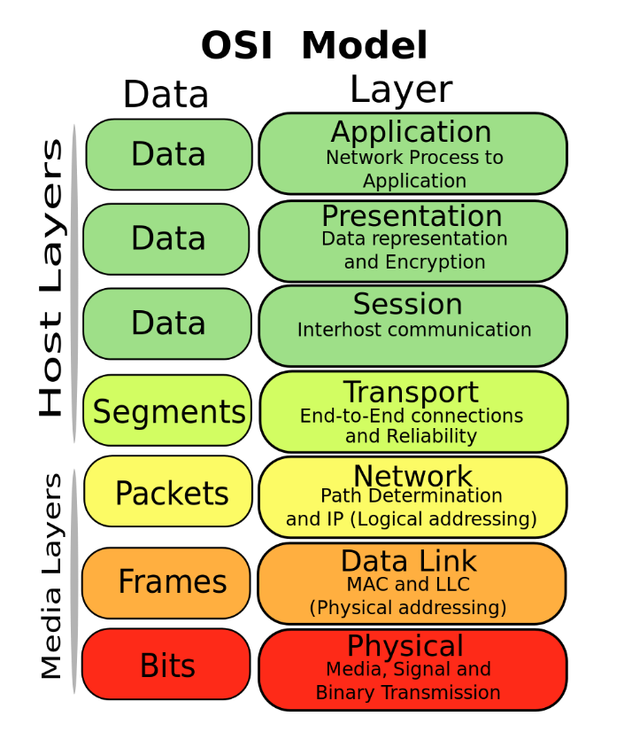
The OSI Model
Diving Into the Layers
Application
Presentation
Session
Transport
Network
Data Link
Physical
Pneumonics All People Seem To Need Data Processing
Please Do Not Teach Sales People Anything
People Don’t Need Those Stupid Packets Anyway (UDP joke)

Slide 88

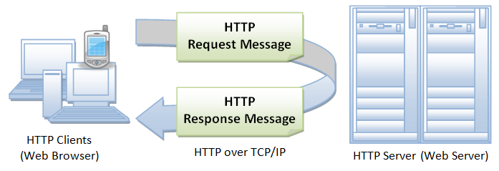
The OSI Model
Application Layer
Application
Presentation
Session
Transport
Network
Data Link
Physical
How users and application processes access network services. Opens what was sent, or creates what is to be sent.
Web browsers (HTTP/S)
File transfer (FTP)
Email (SMTP)
Notes:
Layer 7 Explain that the application layer is responsible for representing data in a way the consuming application can understand.
For web apps, this means HTTP (or HTTPS, which is the encrypted version).
Remind students of the HTTP request from before.
For email applications, this would be a different protocol, called SMTP.
Emphasize that, at this level, data is formatted for user-facing applications to consume.

Slide 89


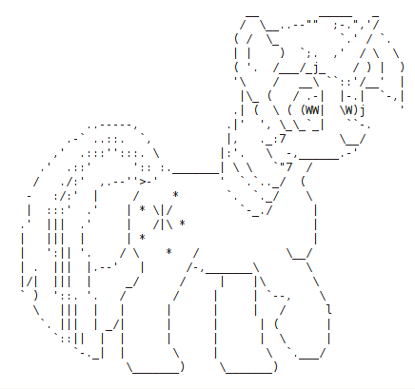
The OSI Model
Presentation Layer
Application
Presentation
Session
Transport
Network
Data Link
Physical
The “Translator” for the network. Handles data representation, encryption/decryption, character set translation, conversion, etc.
Formats the data to be presented to the Application Layer. 0s & 1s <-> Files
JPEG/GIF
ASCII
XML/JSON

Slide 90

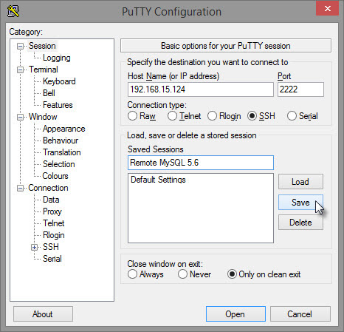

The OSI Model
Session Layer
Application
Presentation
Session
Transport
Network
Data Link
Physical
Manages connections between ports on computers, handling data flow.
RPC, SQL, ASP
Logging, Name Recognition, Logical Port management
Establishes sessions – logical connections between processes running on different stations

Slide 91

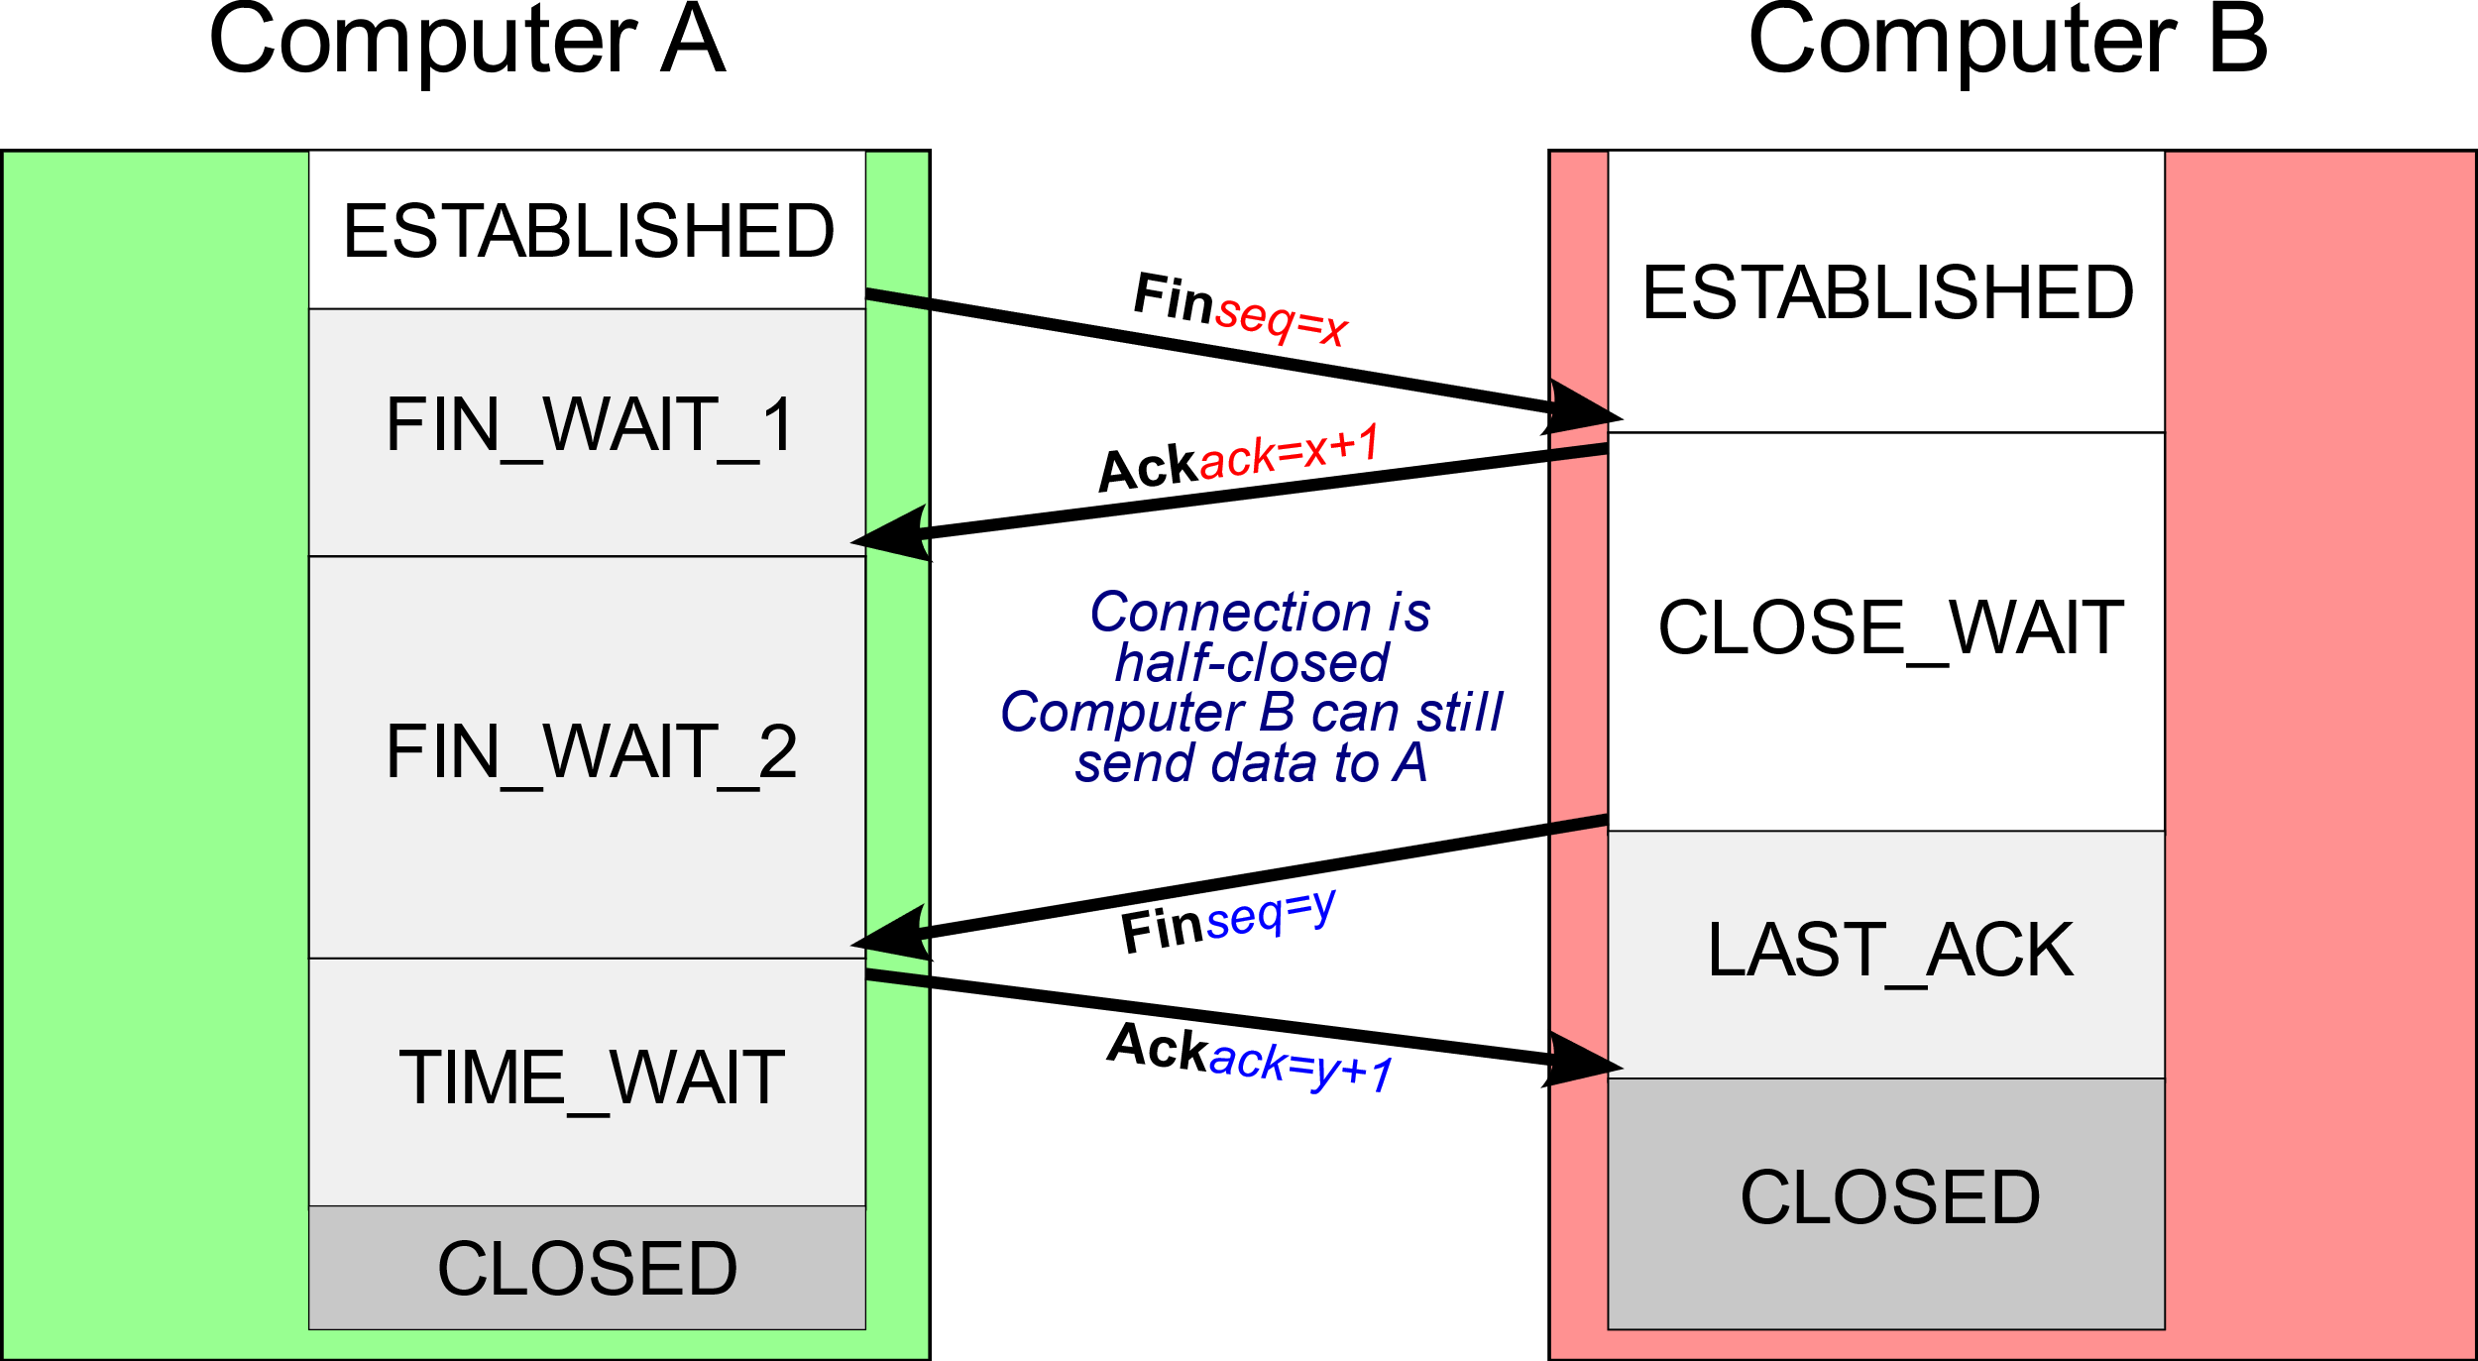
The OSI Model
Transport Layer
Application
Presentation
Session
Transport
Network
Data Link
Physical
Sends data to/from user applications, and breaks data into sendable chunks.
TCP – Transmission Control Protocol
UDP – User Datagram Protocol
Controls how much bandwidth apps use up, handles dropped data, etc.
Notes:
The transport layer is responsible for actually transmitting data across the network. In other words, it’s the layer that puts the data onto the network.
For example, when a user tries to send a message with an email app, the email app will wrap up their message, attachments, the subject line, etc., into a package that the recipient’s email application can understand. This is, e.g., the SMTP protocol.
This package is a bunch of data, which the recipient’s computer could understand…If it ever received the data.
To actually get SMTP data from computer to computer, we need to use a different set of rules/protocols. Those are the transport protocols, which actually transport application data between devices.

Slide 92

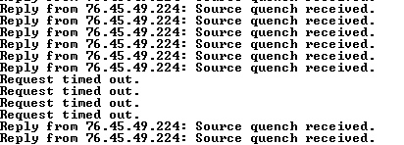
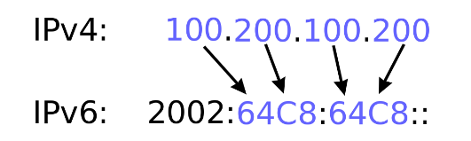
The OSI Model
Network Layer
Application
Presentation
Session
Transport
Network
Data Link
Physical
Ensures data gets to the right networks. This layer decides which physical path the data will take.
Figures out which device to send data to next
IPv4, IPv6, ICMP
Path determination, logical addressing
Notes:
The Network layer is responsible for routing data through physical networks.
The Network layer ensures data gets to the correct destination.
Network-layer devices use IP address to identify target networks.
Network-layer devices use a protocol called ARP, or Address Resolution Protocol, to map IP addresses to hardware addresses.
This allows network hardware to map an IP address to an real, physical machine.
We’ll discuss this process in greater detail when we discuss switches.

Slide 93

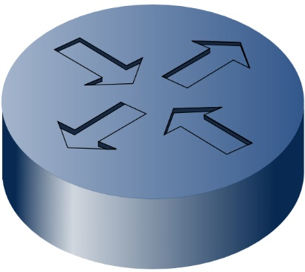

The OSI Model
Data Link Layer
Application
Presentation
Session
Transport
Network
Data Link
Physical
Establishes links between nodes, provides error-free handling of data transfer over the Physical layer.
Routers
802.11
MAC
Other Network Devices
Notes:
This typically involves data being fed to a network adapter (e.g., a network card).
Each physical network adapter is assigned an IP Address so that it can connect to the network
This network adapter is responsible for packaging data from the computer’s physical hardware and passing it to a router for further transport along the network.

Slide 94


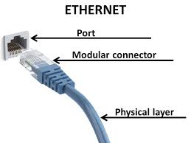
The OSI Model
Physical Layer
Application
Presentation
Session
Transport
Network
Data Link
Physical
Transmits the raw bit stream over physical medium
Ethernet - moving data across physical wires
Bluetooth
Wireless, 3G
Notes:
This layer has to do with signals and binary transmission – getting bits from point A to point B physically.

Slide 95
The OSI Model

Slide 96
The OSI Model
Notes:
Point out that communication goes through each layer of the model, slowly growing the data frame to incorporate things like protocol information, security measures, and other information.

Slide 97
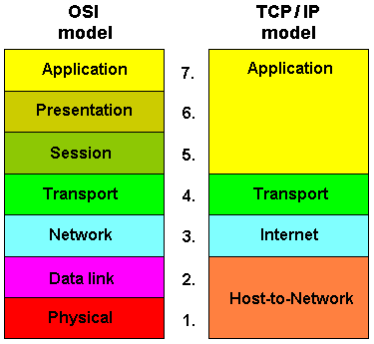
Note: Another Model
The TCP/IP model serves a similar purpose as the OSI Model, with only 4 layers instead of 7.
Notes:
Explain that also used in the industry is the TCP/IP model, which is similar but with less granularity. Leave it at that.

Slide 98
Activity: Fill In the Blanks (10 min)
On a piece of paper, write out the numbers 1 through 9.
For each layer (starting at the bottom), give the following:
Layer Name
Function
Relevant Protocols
Any other information you know about the layer
For 8 and 9, explain the process that is labelled.
Bonus:
Draw your own version of the OSI Model, labelled.
8
9
7
6
5
4
3
2
1

Slide 99
Review Fill in the Blanks
8
9
7
6
5
4
3
2
1
8: Encapsulation
9: Decapsulation

Slide 100

Activity: Partners OSI Model HTML (15 min)
Instructions:
Explain to your partner the OSI Model and each of its layers
Investigate how one requests and receives an HTML files
Draw the request and response cycle using the OSI Model as context.
Investigate some of the protocols used. Try to get a general understanding of the path the communication takes.

Slide 101
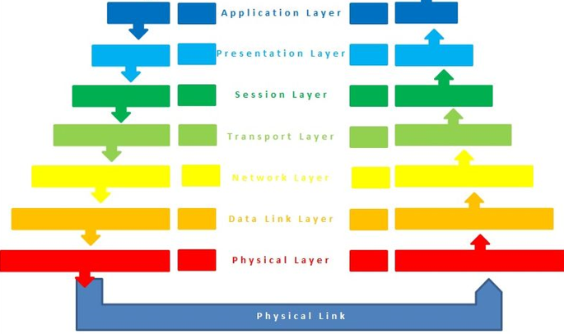
Review HTML and OSI
Request
“I’d like file X.html please”
Request received
Convert application text data to bits
Convert data bits to application text data
Add headers so that dest knows it’s an HTTP request …
Pulls packets together, determines protocol
Connecting to the IP of the server…
Manage physical connection, collect data
Set up connection to send bits
Transmit data
Receive data
Headers + Content:
010010011 000000001…
Protocols used: HTTP, TCP, IP

Slide 102

Review HTML and OSI
Response
Application parses response X.html and renders web page
“Here’s file X.html !”
Convert file to bits
Convert data bits to file
Add headers so that dest knows it’s an HTTP response …
Pulls packets together, determines protocol
Connecting to the IP of the client…
Manage physical connection, collect data
Set up connection to send bits
Transmit data
Receive data

Slide 103
Lesson Recap

Slide 104
Today’s Goals
By the end of class, you will be able to:
Define Network and understand the principles by which computers communicate
Define Protocol and their relevance in network communication
Define OSI Model and explain each layer
Map communication types and protocols to OSI Model layers
Explain the steps of network communication in the context of the OSI Model
Notes:
But today, we’re going to… Review goals, address questions.

Slide 105
Resources
OSI Model as explained by ordering pizza
TCP vs. OSI Model

